Slide 1
STOCK MARKET PREDICTION
BODHISATTVA DASGUPTA

Slide 2
CONTENTS
Introduction
Data Collection and Cleaning
Visualization
Model Development
Prediction on new model
Summary

Slide 3
INTRODUCTION
Predicting stock market prices is essential for investors and financial analysts. In this project, we use Linear regression to forecast stock prices. By analyzing historical stock data and financial indicators, we aim to develop a model that provides accurate predictions of future stock prices.
This project involves data collection, visualization, model training and use it on new data to predict the closing price of the stock.

Slide 4
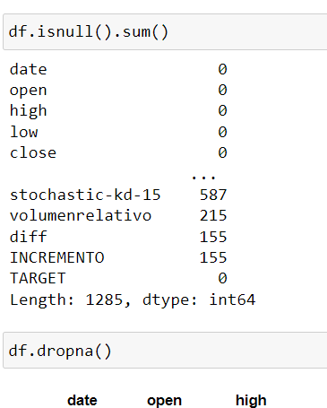
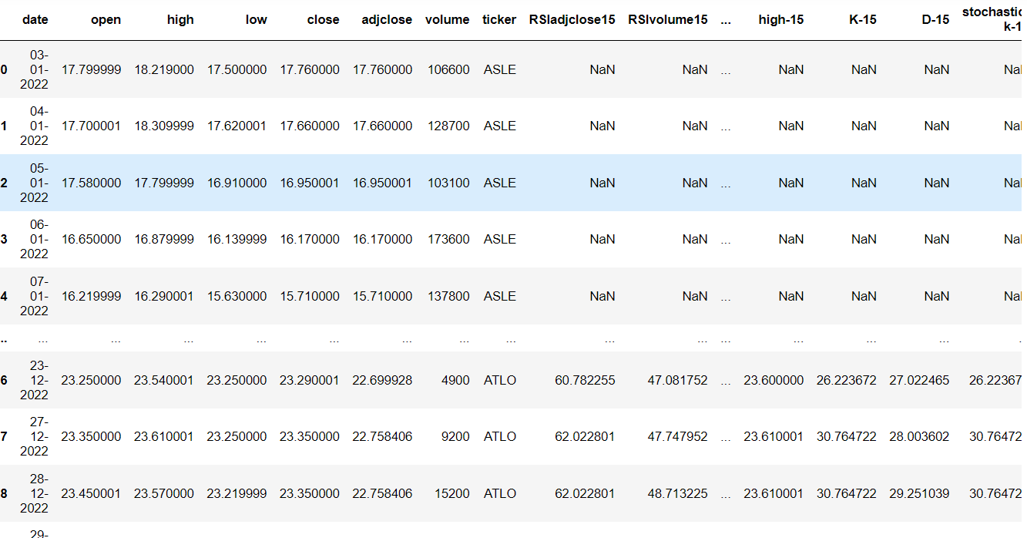
Data collection& DATA Cleaning:
|
|
|||||
The original dataset:
https://drive.google.com/file/d/1d3bgB4aodpWMW_CJFFejFUBobwSye9Dm/view?usp=drive_link
A Dataset was collected from Kaggle. It consisted of 32 companies and the volume of their stock traded everyday for the year 2022. Each row consisted date, High (highest value of the stock on that day), low (lowest value of the stock on that day), Open (Opening value of the stock on that day), Close (Closing Values of the stock on that day)
Handling missing Values: identifying missing values with ‘df.isnull().sum()’ and removing them using ‘df.dropna()’ to maintain data integrity.

Slide 5
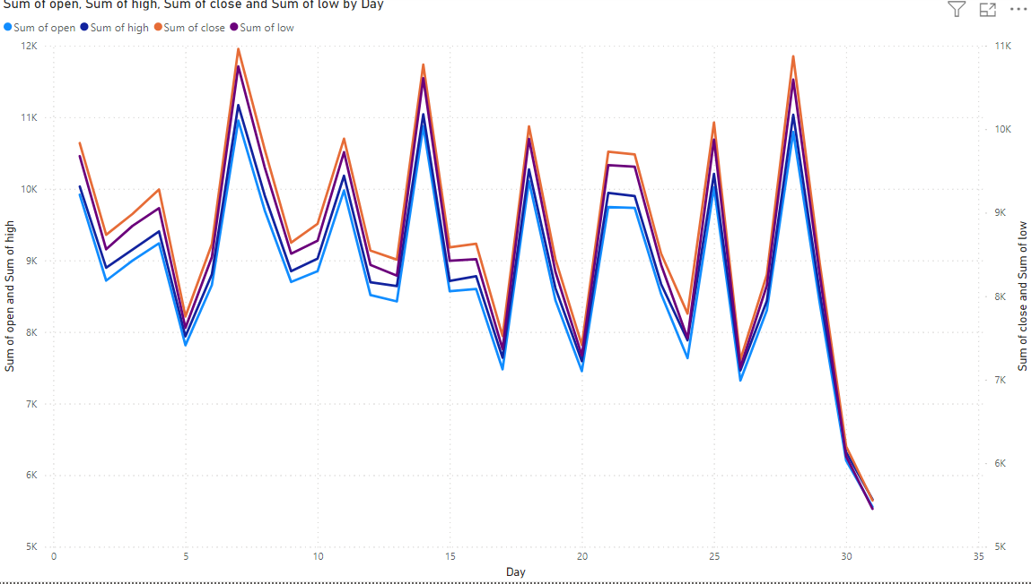
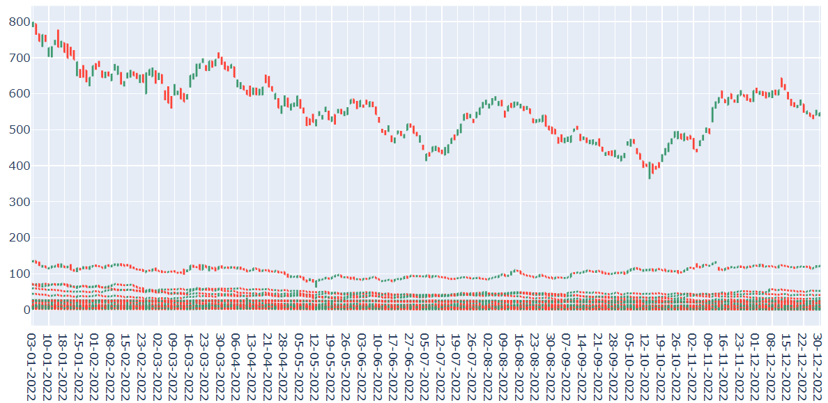
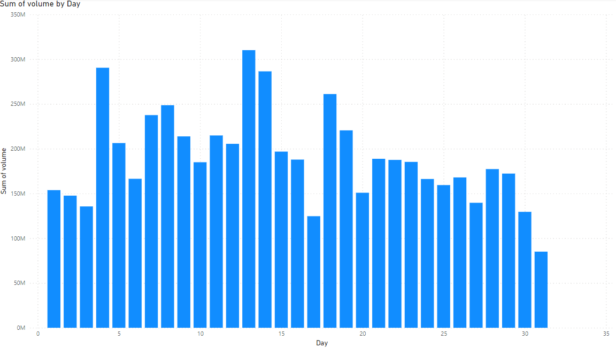
Data Visualization
The dataset employed consists of historical Stock prices from various companies, incorporating features such as open, close, high, low prices and trading volumes. The visualization has been done using power bi.
OHLC visualization has been used to indicate stock price movements within a specified period, providing comprehensive view of market behaviour. The OHLC graph was produced by “plotly”. In the graph below, the red stocks indicate Bearish and the green ones are bullish.

Slide 6

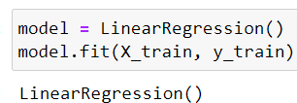

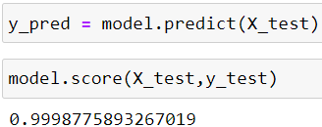
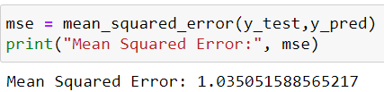
Model Building
Opening Price of the stock, highest price of the stock, lowest price of the stock and volume of stock traded were considered as independent variable, closing Price of the stock was considered to be the dependent variable. Then it was divided into 80% training data and 20% testing data using train_test_split of scikit_learn.
A linear Regression model was bulit and the training was done
_______________________________________________________________________________________________________________________
The mean squared error (MSE) is very low indicating, that the predictions made by the linear regression model are quite close to the actual values, with small errors on average. An MSE of 1 can be considered quite good, depending on the scale of the stock prices being predicted.
Both the training and testing were 99% accurate

Slide 7
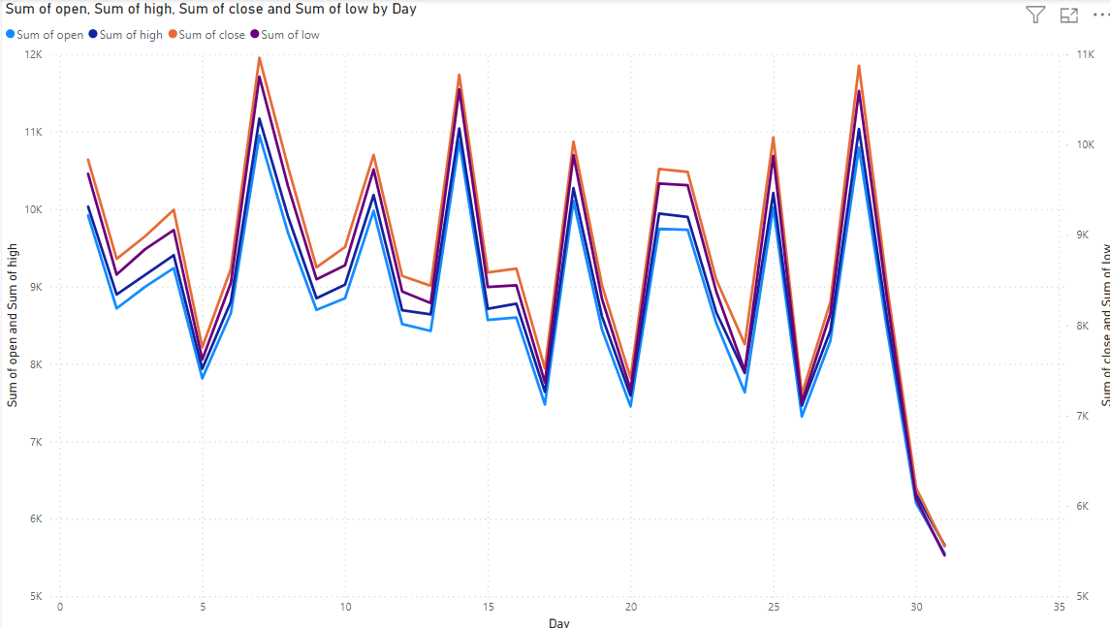
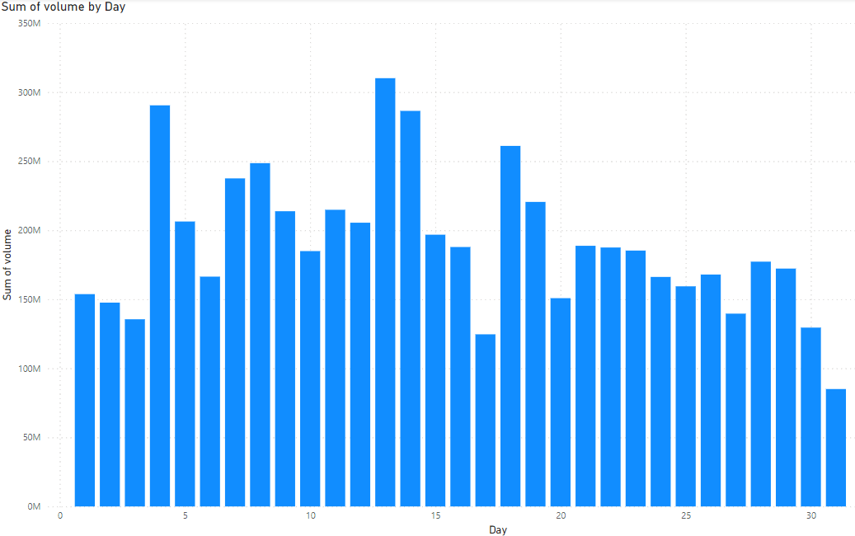
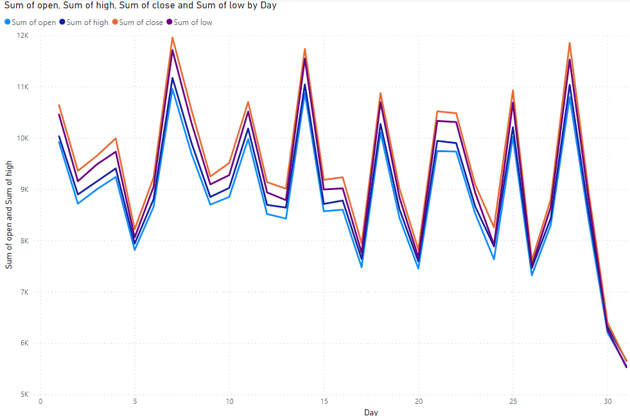
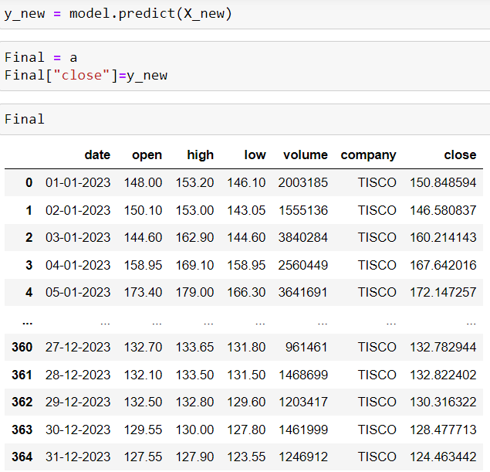
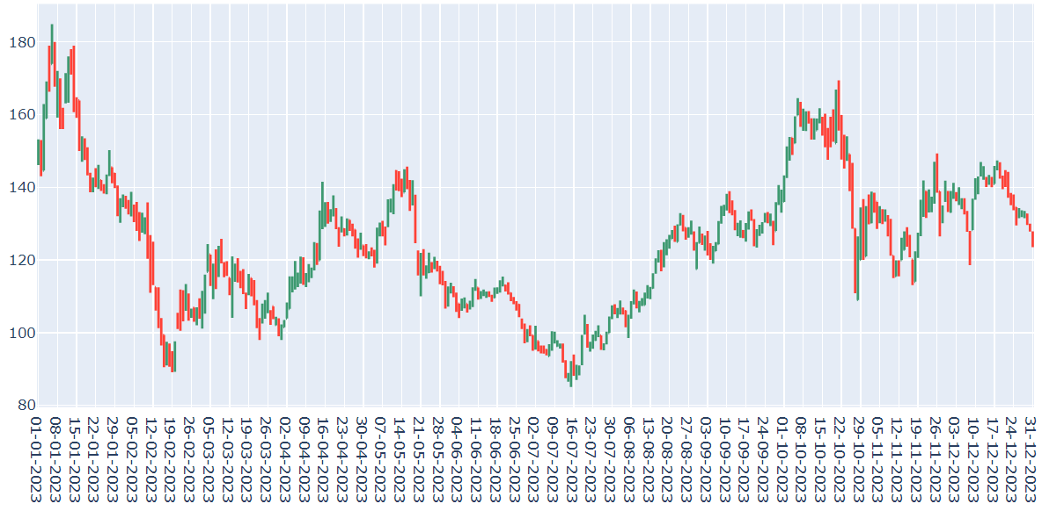
Prediction on new data
A new data was downloaded from Kaggle which consists of opening price, highest price, lowest price and volume of TISCO shares traded everyday in 2023.
Volume of stocks traded everyday
Highest, lowest and opening values of TISCO stocks
______________________________________________________________________________________________________________________________
The previous model was used to predict the closing price of TISCO stocks
The final predicted dataset: https://drive.google.com/file/d/11HOBwuLZ6tA_hX6_UDIQGX6dLgwtAC8S/view?usp=sharing

Slide 8
SUMMARY
In this stock market prediction project, Linear Regression was used to forecast stock prices of any random company( in this case TISCO) based on historical data. The model’s performance was evaluated using Mean Squared Estimator (MSE). This model achieved a MSE of 1.035, indicating that predictions are very close to the actual stock prices. This result demonstrates the effectiveness of Linear Regression in providing accurate and reliable stock market predictions. But this can also be done and explored with more complex models to further enhance predictive accuracy.

Slide 9
THANK YOU
BODHISATTVA DASGUPTA
bodhisattva.2024@gmail.com

